Slide 1
FlexiVoice
Make voice interaction work for you!
Esther Goldstein, Rachel Jorgensen, Ron Tep

Slide 2
Problem/Solution Overview
People want to be flexible in how they interact with their smart devices
Our app allows you to:
  Keep track of your devices
  Define your own commands
  Share information about your devices with others

Slide 3
Tasks

Slide 4
Help my visitors interact with my smart devices (simple)
Sheila: owns a smart home and rents out a room with Airbnb.
Visitors don’t know how to turn on the smart devices
Wants a way to inform her guests what to say to her Google home in order to turn on the lights and other appliances

Slide 5
Say what I want to my voice assistant (medium)
Hunter: working professional who uses Amazon Echo
Frustrated when he expects a command to be one thing but learns it’s something else
Example: wants to say “Alexa, turn on my living room fan” instead of “Alexa, turn on Dyson.”

Slide 6
Keep track of my smart devices (complex)
Lily: rents a house with her friends
Forgets which device is in which room when giving a command
Wants way to keep track of which devices they have, where they’re located
Wants to know statistics on the devices and find the one closest to her

Slide 7
Storyboards

Slide 8
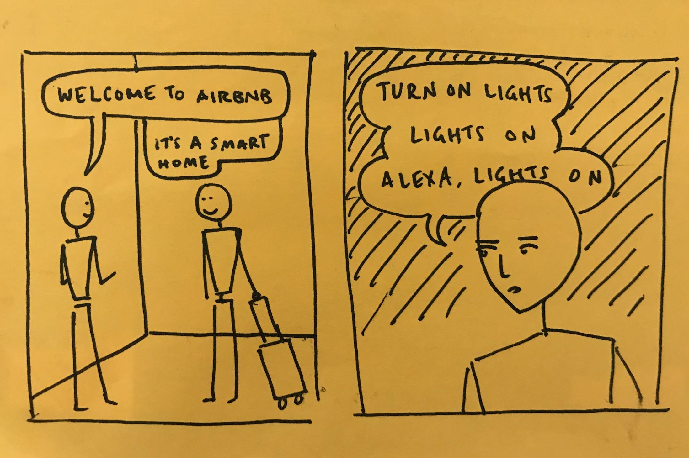
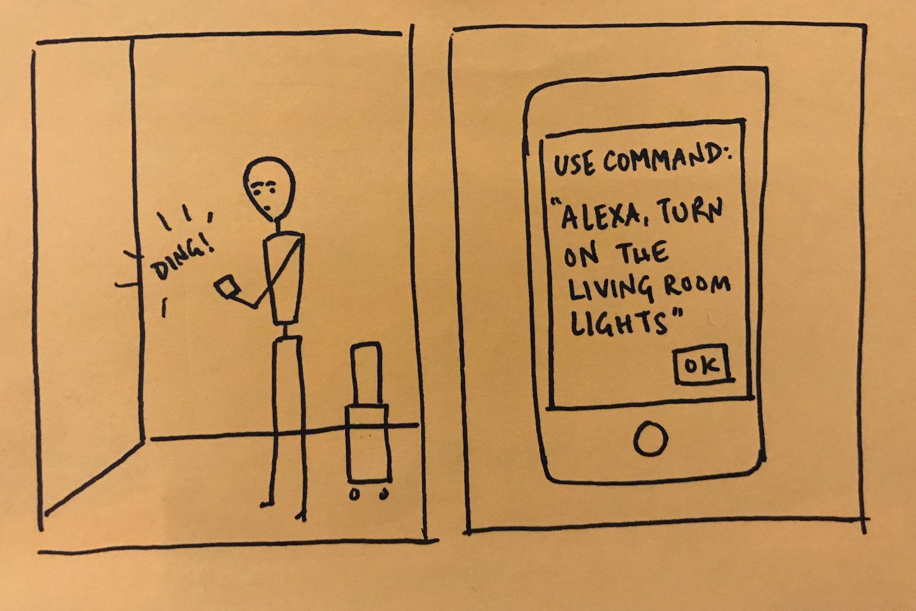
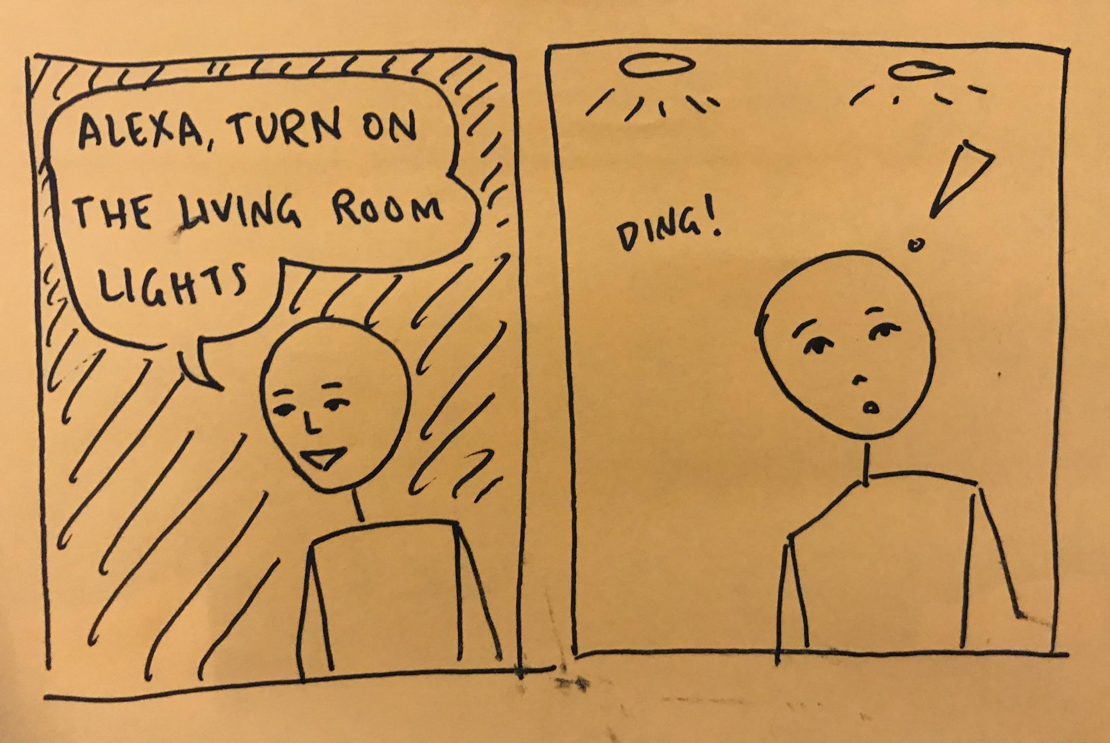
Help my visitors interact with my smart devices

Slide 9
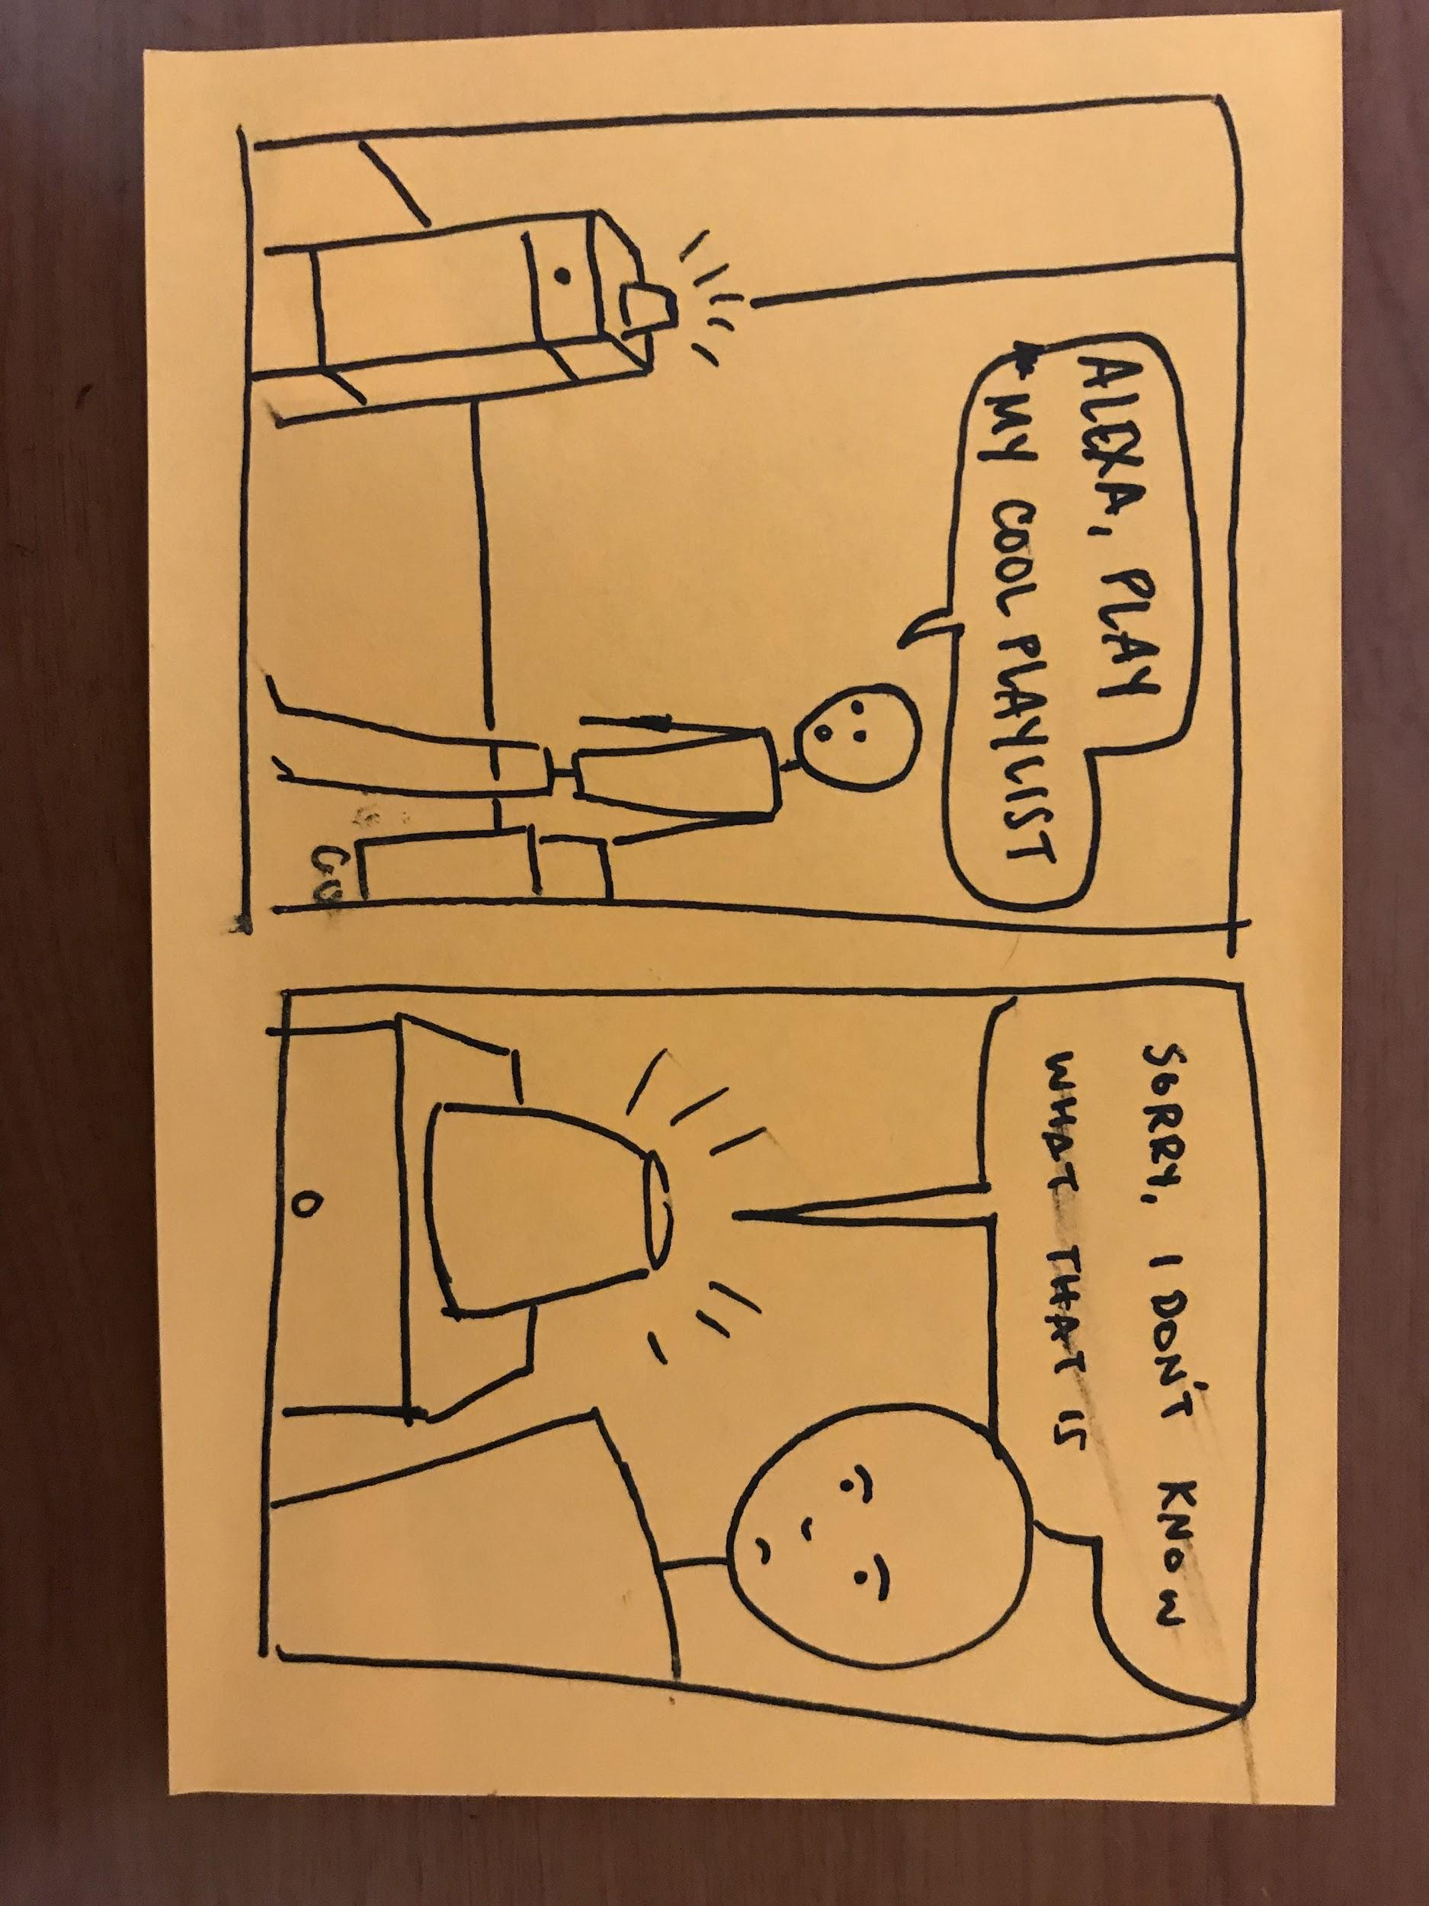
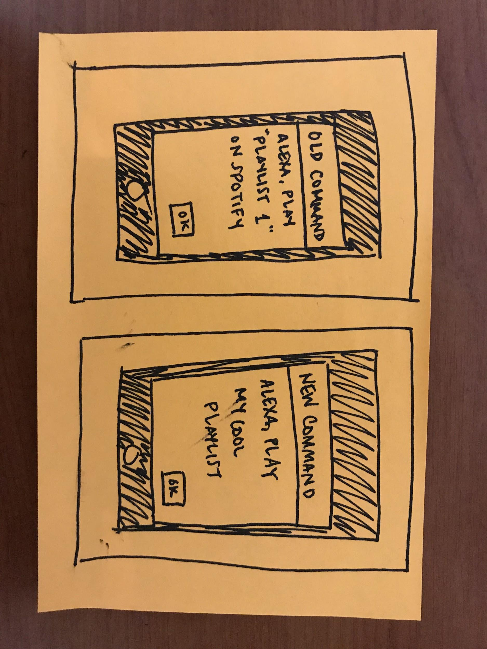
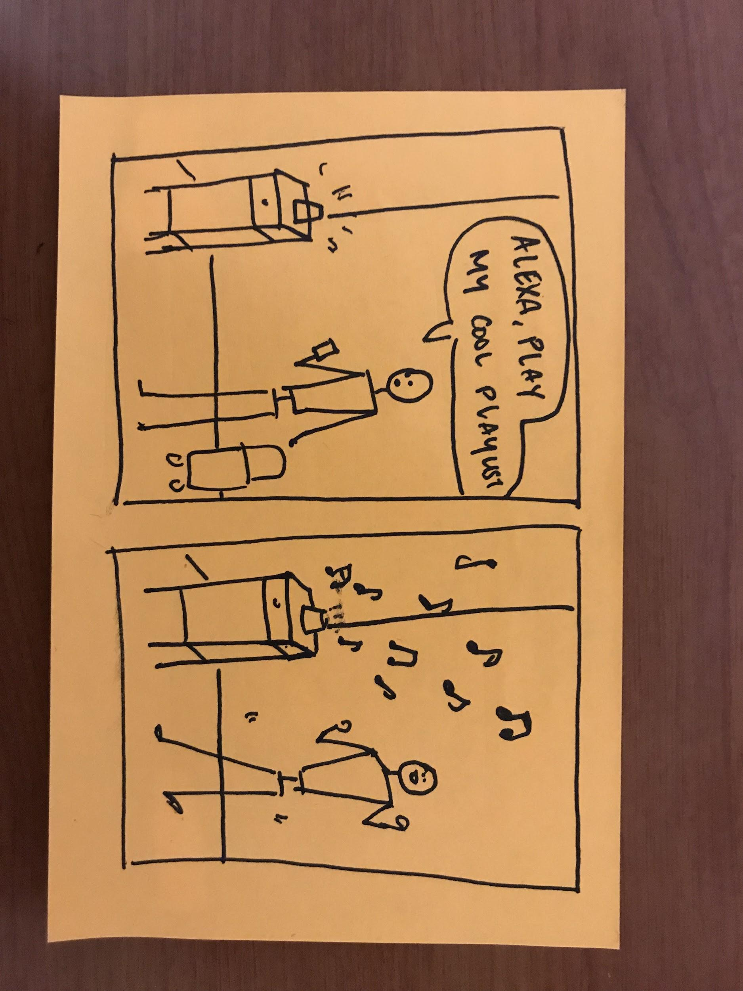
Say what I want to my voice assistant

Slide 10
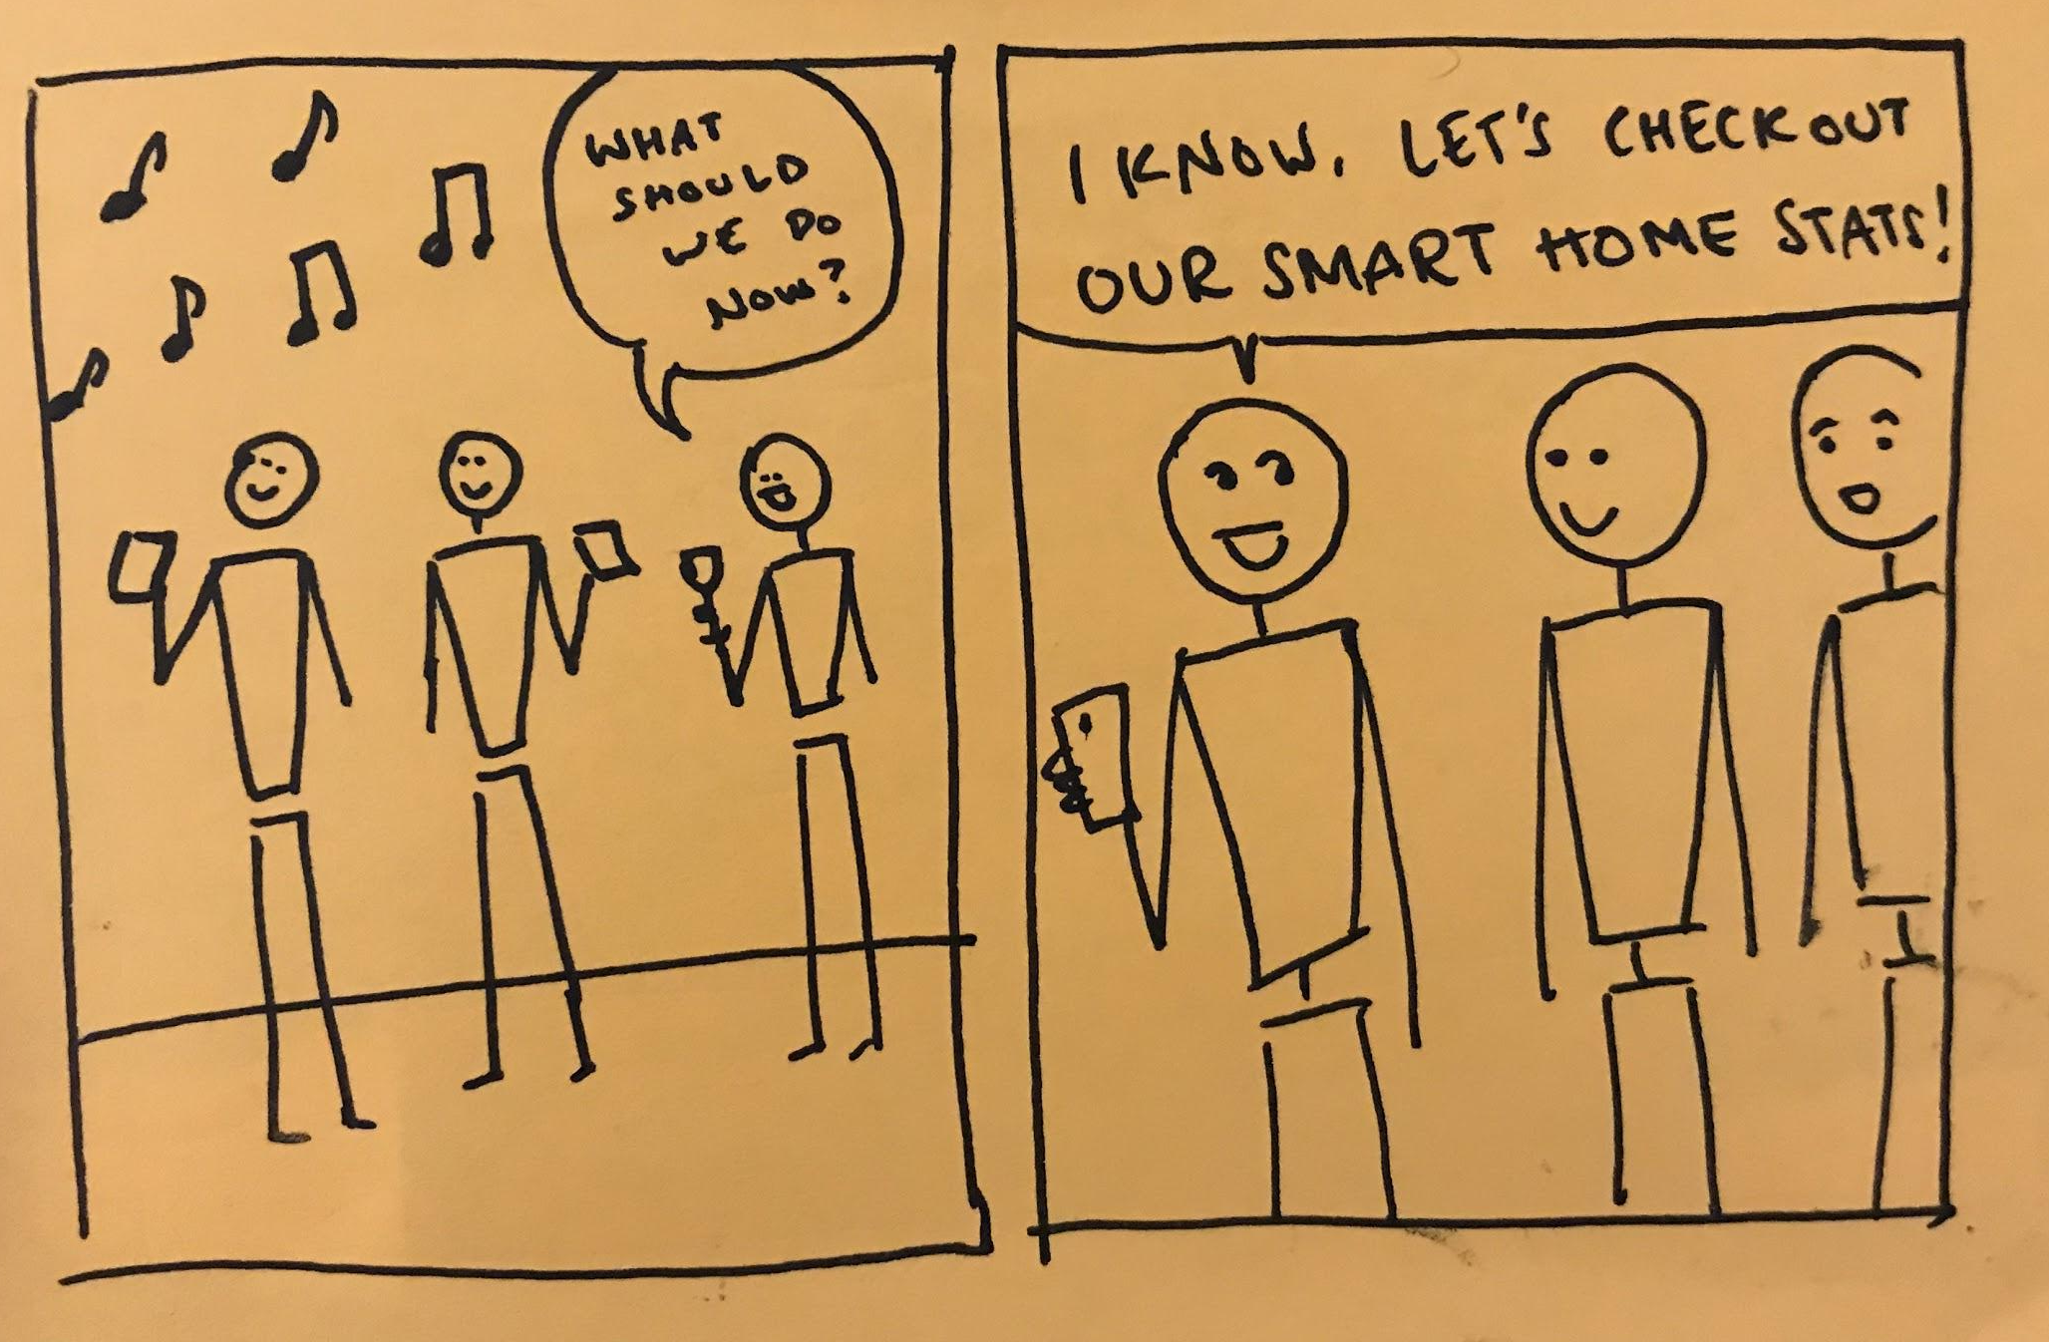
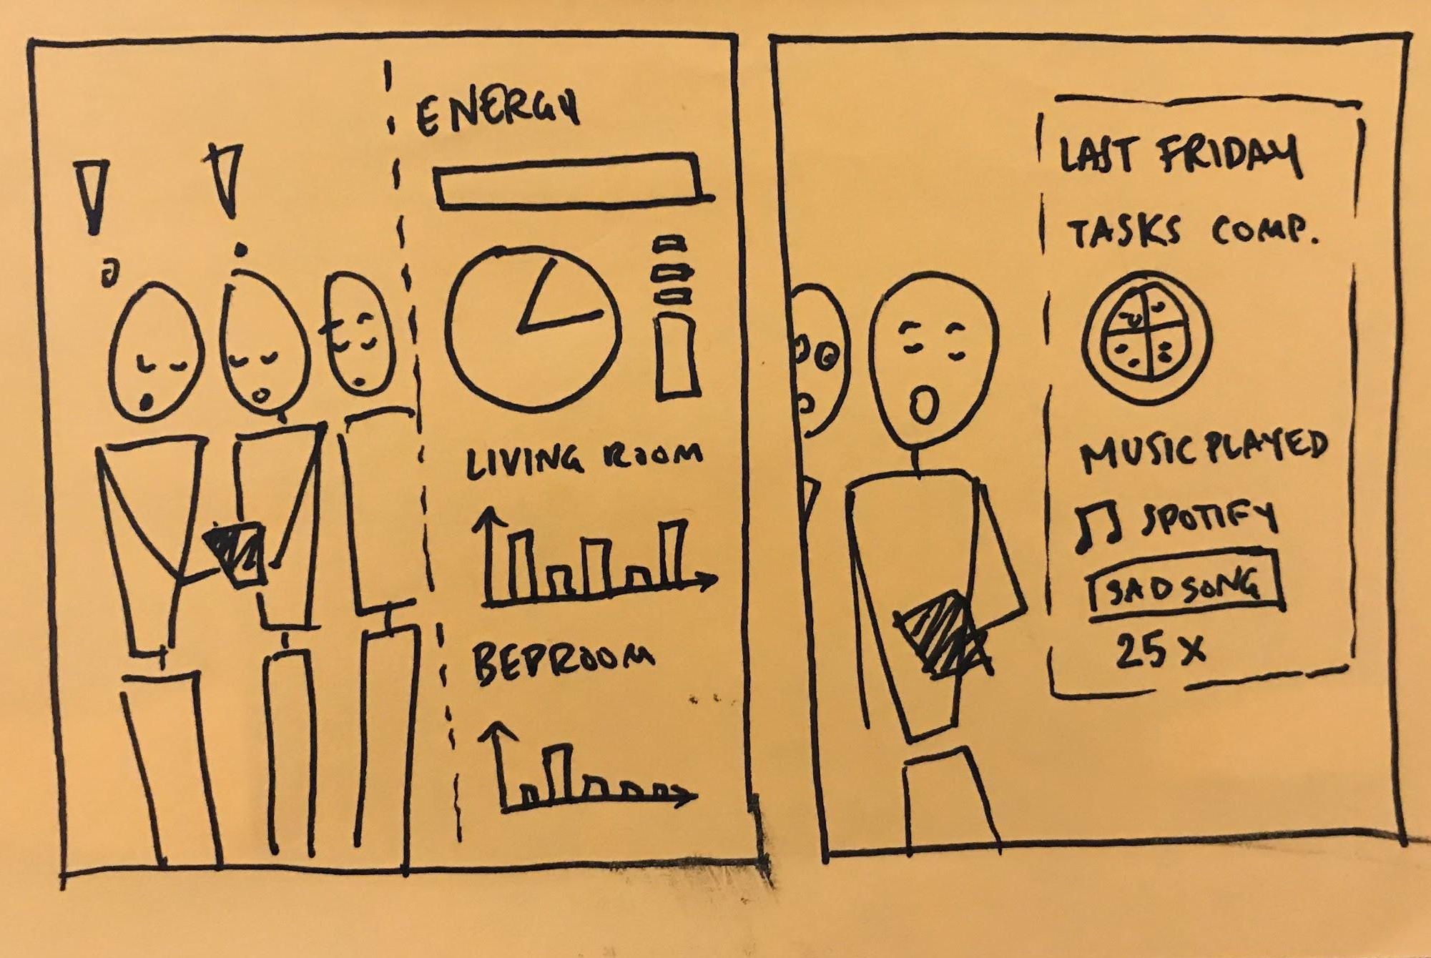
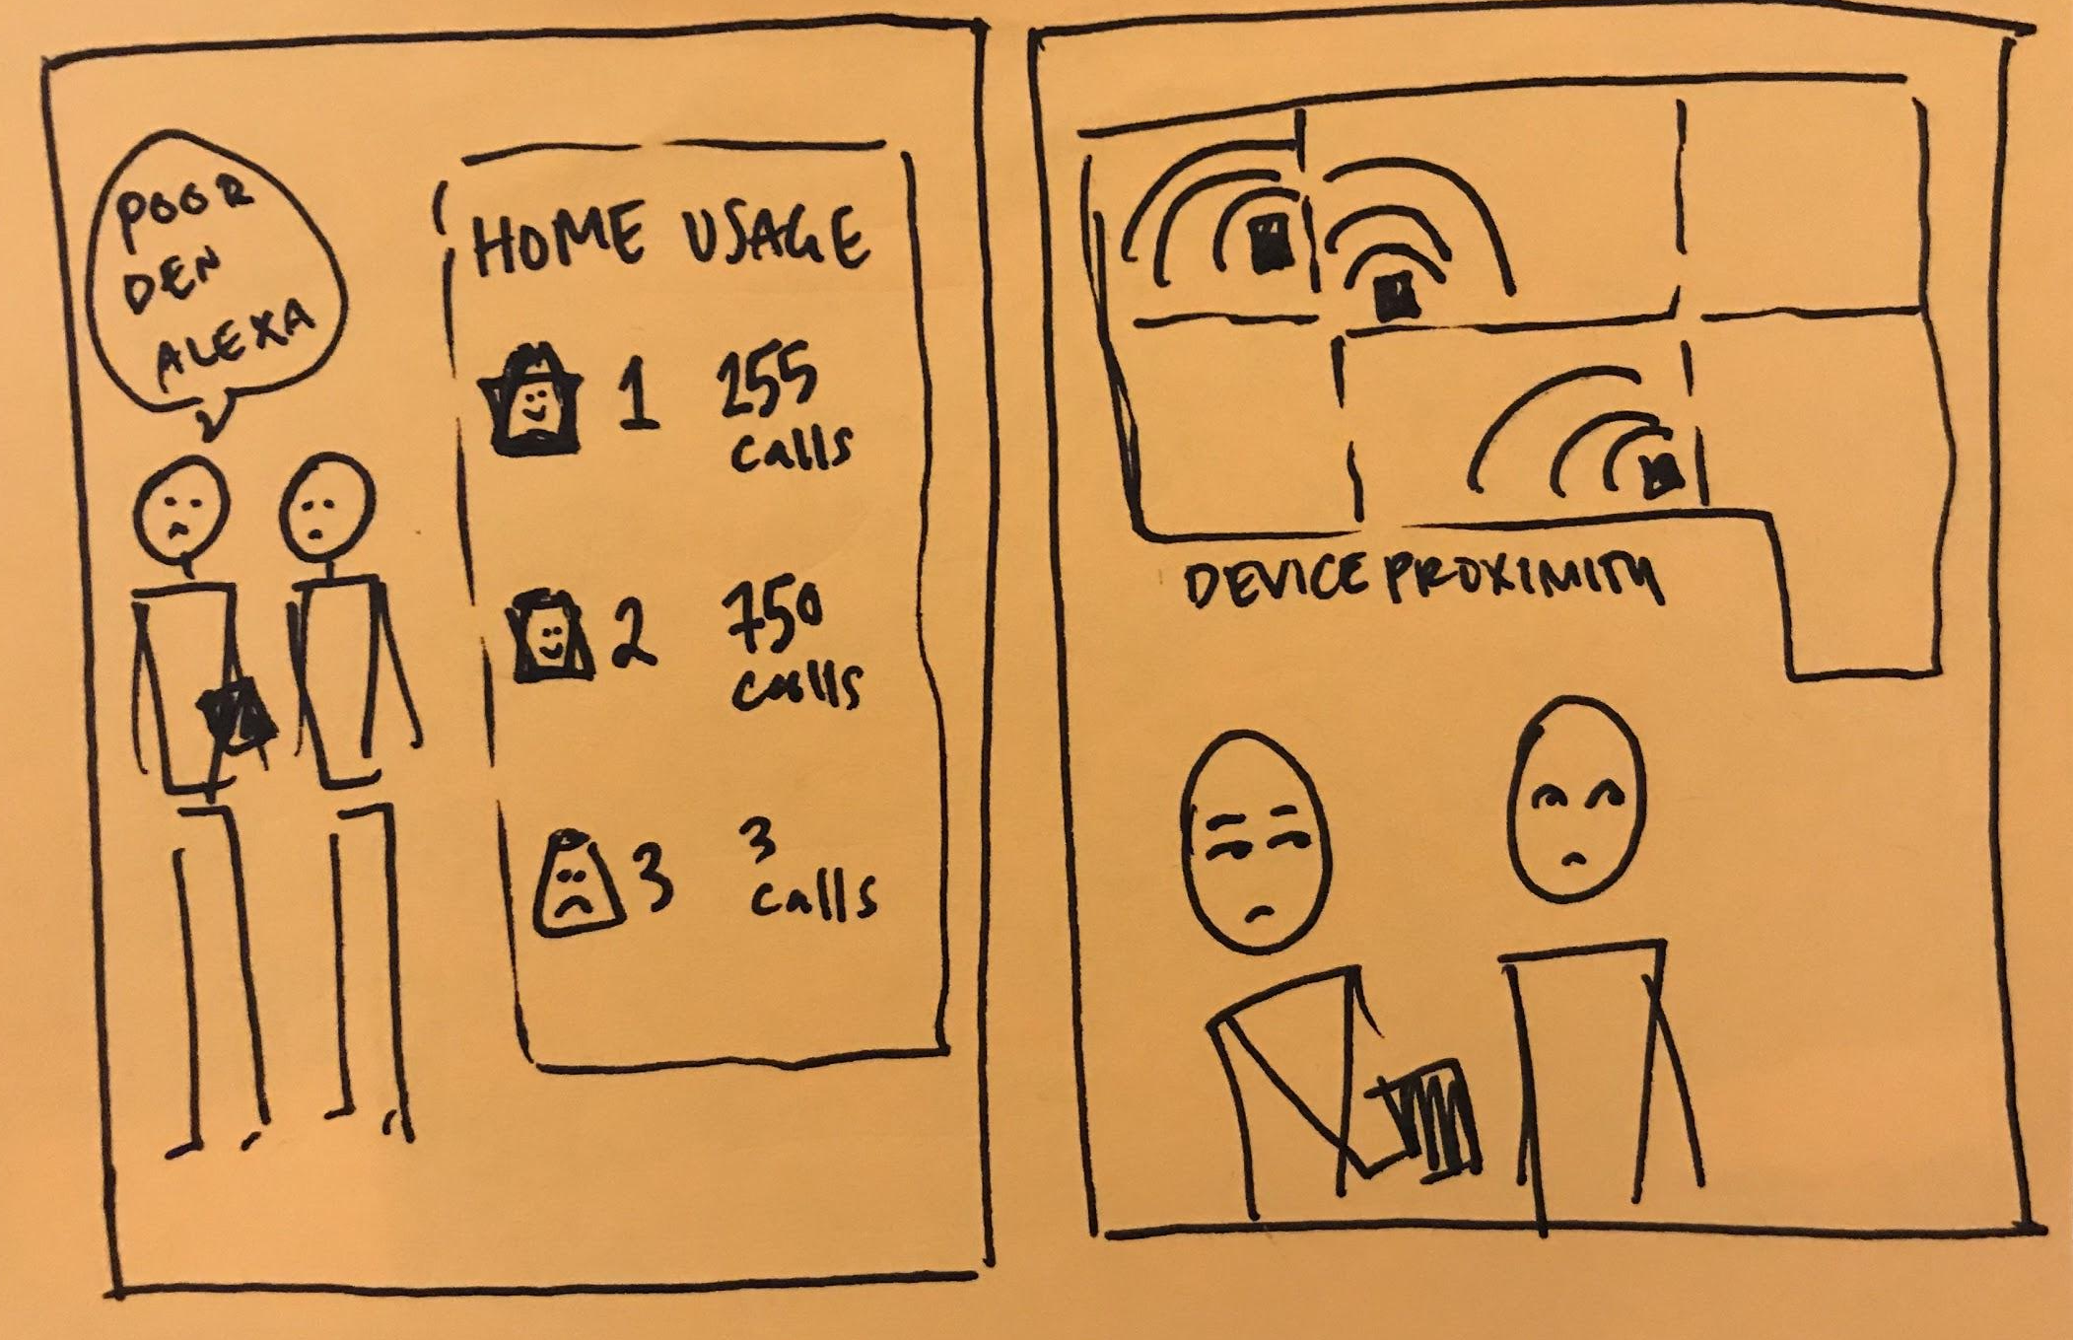
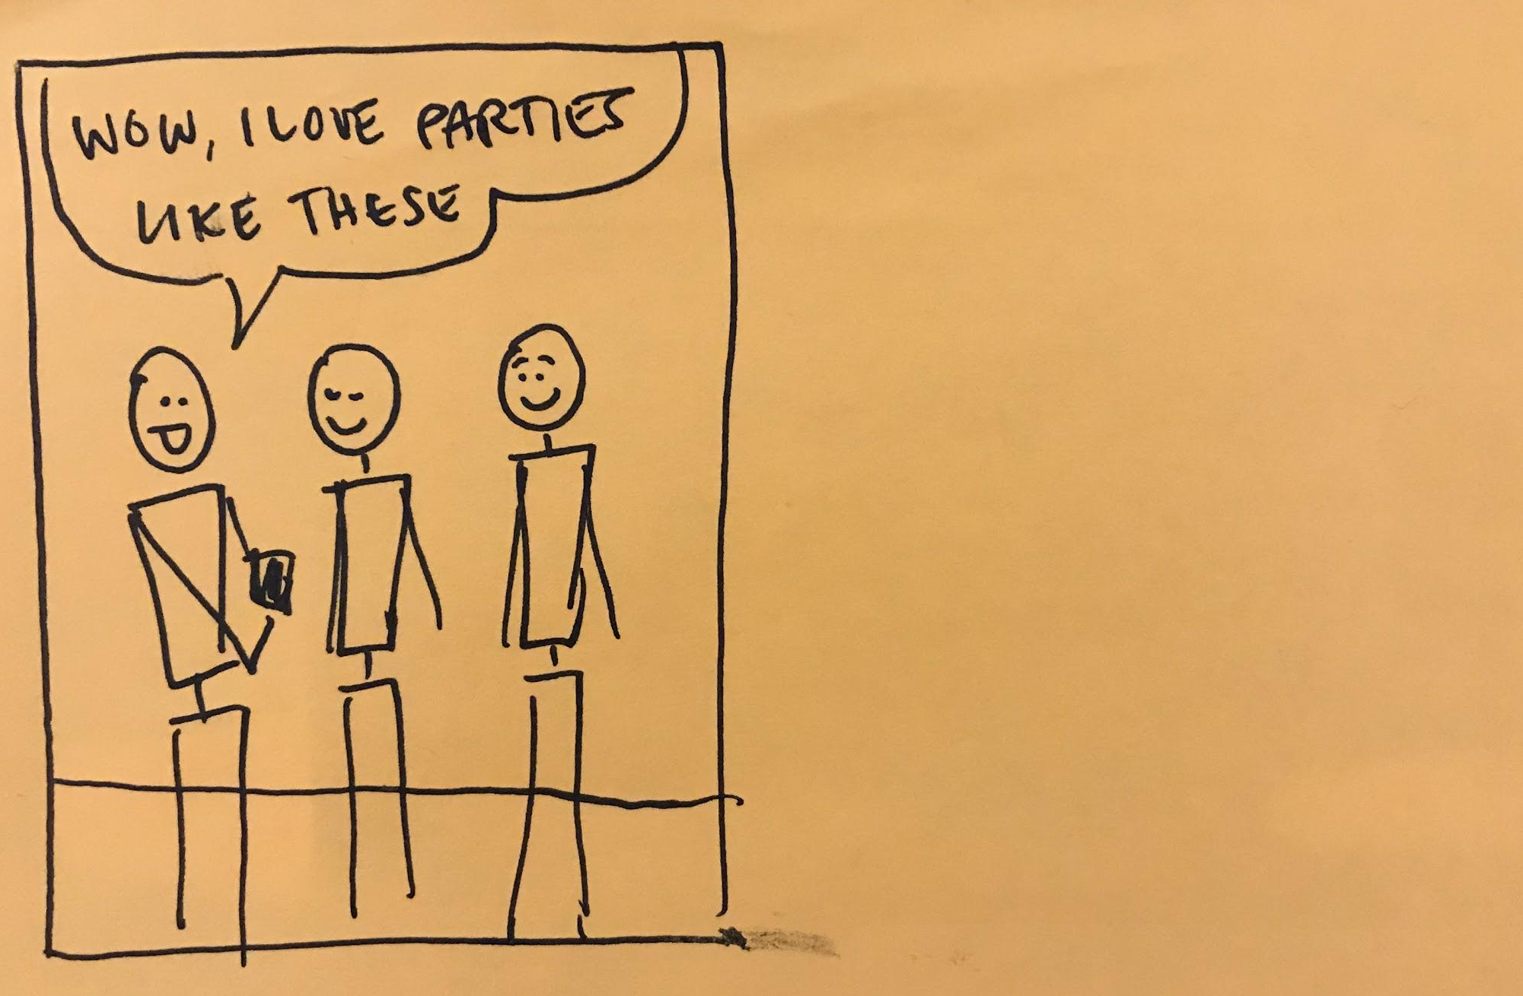
Keep track of my smart devices

